Slide 1

EUF KO Quality
Pranav Bapat

Slide 2
What is a KO?
Metadata
+
Content (knowledge object)
+
Controlled vocabularies (facets)

Slide 3
BUT
“Not all of these contribute equally to meaning or retrieval.”

Slide 4
Many KOs are extremely long or extremely short and/or noisy
Many KOs contain:
  Repeated text
  Boilerplate paragraphs
  Legal disclaimers
  Formatting leftovers
  Irrelevant content
Embedding models and search engines struggle with these.
RAG systems perform poorly when fed large, irrelevant, unfiltered context.
Outcome:
  Lower retrieval quality, higher hallucination risk, slower search, and unnecessary compute.

Slide 5
Why KO quality matters?
Knowledge Objects are only useful when:
Fairness across projects and countries and languages
Higher user trust and adoption
Search ranking stability
Better semantic retrieval
Reduced chatbot hallucinations
They can be found (searchability).
They can be understood quickly (clarity).
They are consistent with the industry standards.

Slide 6
Poor-quality KOs lead to:
Irrelevant or wrong search results
Missing or wrong filters
Weak chatbot responses
Noisy embeddings

Slide 7
The Problem

Slide 8
Some examples
67d1a83dd2f3ec5aa09a5aba
68b553b100f60afb29427754
686e1fd5497da684268d9dda
68b55330017b8b75556d9ef1
68773f88e4df4f63e71d9007
6716ac6f209cd9bd370e5972
66b1f00e45168fd6c4c56ea8
686f6d6cdaff72a695636f22
These issues are not rare edge cases; they are common patterns.

Slide 9
What Do We Mean by “KO Quality”?
How correctly, clearly and usefully a KO's metadata (title, subtitle, description, keywords) describes its file
Both for a reader and as input to search, indexing and RAG.
Metadata quality = Structural + Semantic + Functional (pillars informed by ISO/IEC 25012; Bruce & Hillmann 2004; Ochoa & Duval 2009)
Structural = length + completeness + noise + formatting
Semantic = consistency + information density + clarity + usefulness
Functional = findable by keyword search (BM25) + by meaning (embeddings)
Domain = a gate, not a pillar: off-domain KOs are not scored
The file's own content is measured and reported, never scored (it is the author's work)

Slide 10
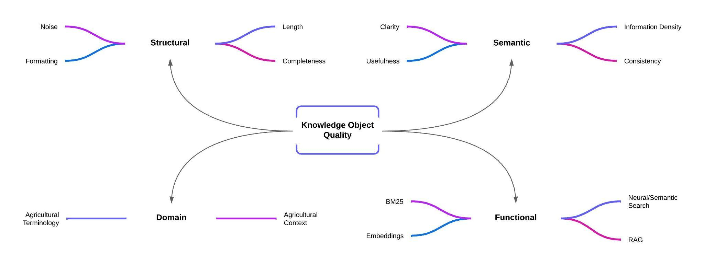
What Do We Mean by “KO Quality”?
Now: Domain is a gate (off-domain KOs are not scored). Functional is measured as BM25 and embedding findability; RAG and neural search are not scored separately.

Slide 11
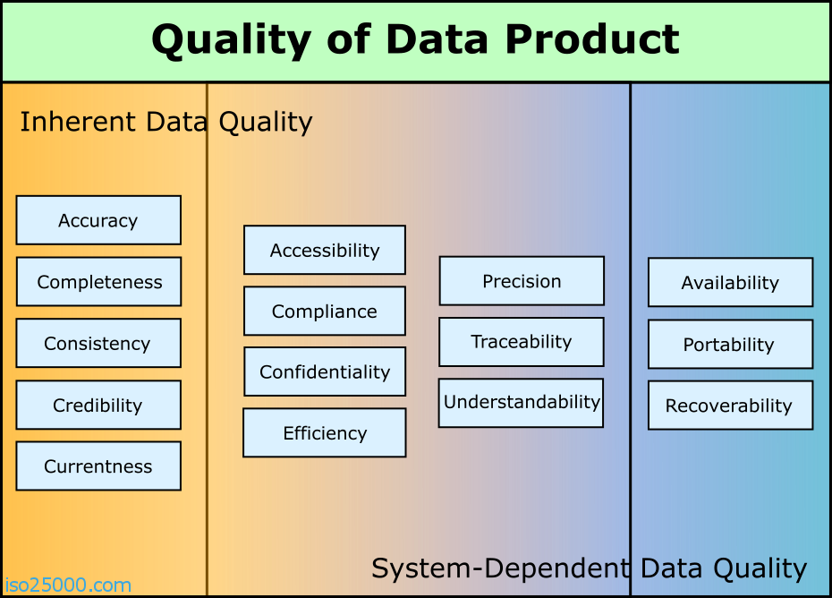

Slide 12
Sample Knowledge Object
"@id": "https://ugent-dict-farmbook-prd.s3.ugent.be/knowledge-object-prd/7c9e43d16b50ec66ab4d503584e23456",
"title": "Women Innovators in Ireland - Rural Fact Sheet #038",
"subtitle": "",
"description": "Fiona founded ‘Count on Us Recruitment’ to help family carers in Ireland find flexible part-time jobs (up to 18.5 hours/week) that fit their caregiving needs. Her service connects carers with employers seeking skilled, flexible workers, addressing a gap in the labor market. Fiona was named All-Star Social Entrepreneur of 2022. The initiative supports carers’ wellbeing and helps businesses fill labor shortages.",
"keywords": ["social innovation", "gender equality"],
"creators": ["Maura Farrell, Aisling Murtagh, Louise Weir"],
"languages": ["English"],
"date_of_completion": "2024-07-26",
"intended_purposes": ["Dissemination"],
"locations": [{"name": "Ireland","nuts_id": "IE"}, {"name": "Ireland", "nuts_id": "IE0"}],
"category": "Document",
"topics": ["Society"],
"themes": ["Social innovation"],
"license": "CC BY-SA",
"project_id": "0ebe9ca0be9ebadaf3790db6970305d74a90dba971ec3396f77ec50e672f509c",
"ko_created_at": "2025-09-08T20:39:56.169000",
"ko_updated_at": "2025-09-08T20:39:56.169000",
"project_display_name": "FLIARA",
"project_type": "Horizon Europe",
"locations_flat": ["Ireland"],
"subcategories": ["Factsheet"],
"project_name": "FLIARA: Female-Led Innovation in Agriculture and Rural Areas",
"project_acronym": "FLIARA",
"project_url": "https://fliara.eu/",
"project_doi": "10.3030/101084234",
"proj_created_at": "2024-12-03T13:43:58.802000",
"proj_updated_at": "2025-08-01T09:33:41.800000",
"_orig_id": "68650ce67807d9bc7a0b3d82",
"ko_content_flat": "Rural Fact Sheet # Count On Us Recruitment THE INNOVATION JOURNEY Fiona established 'Count on Us Recruitment' to offer a unique service to family …… ……. USEFUL LINKS https: //countonusrecruitment.ie/"

Slide 13
Auditing KO
(What, Why, How)

Slide 14
What we analysed
Full KO export: 10,468 KOs (18 June 2026), audited 19 Sep 2026.
125 fields analysed (every field present in at least 5% of KOs), including LLM-improved (_llm) fields, summarised content and 23 metadata translations.
Fields fall into two broad groups:
  Knowledge-carrying (textual) fields
    title, subtitle, description, keywords, ko_content_flat, and their _llm / summarised versions
  Controlled-vocabulary / facet fields
    topics, themes, languages, locations_flat, category, subcategories, license, project_type, date_of_completion, creators, project_acronym, project_name
Not all fields are designed to carry semantic meaning or support retrieval.

Slide 15
Evidence-Based Field Selection

Slide 16
Why We Need Evidence-Based Field Selection
Not all metadata fields contribute equally to retrieval.
Some fields are highly discriminative (e.g., title, description, keywords).
Others are controlled vocabularies that repeat by design (e.g., topics, themes, category).
We needed to separate semantically useful fields (for search, embeddings, RAG) from facet fields (for filtering and admin).
We wanted this to be data-driven, not based on intuition or schema design.
Without evidence-based analysis, we risk:
  skewed search ranking
  poor semantic retrieval
  unnecessary embedding of repetitive fields
  inconsistent chatbot responses

Slide 17
How We Identified Which Fields Matter
We applied four analytical layers:
Corpus diagnostics
  Coverage, length, normalised IDF, distinct values, value entropy and exact-duplicate share.
Held-out retrieval test (MRR@10)
  1,500 keyword queries from the original text fields; each field ranks all KOs alone (BM25).
Role scores (full-text, facet, sort)
  Combined signals per field; every disagreement with the indexing policy is reported.
Ablation benchmark (nDCG@10)
  Drop one field from the recommended bundle and measure what is lost.
They show which fields carry signal; they do not optimise content.

Slide 18
How Fields Were Evaluated
Each field was examined along five questions:
Coverage - Is the field consistently populated across KOs?
Textual richness - Does it contain enough meaningful language to carry information?
Redundancy - Is the same value repeated across many KOs?
Discriminative power - Are its terms specific (normalised IDF)?
Retrieval - Can the field alone find the right KO for a query?
Together, these signals indicate whether a field is suitable for:
semantic quality,
retrieval,
and downstream reasoning.

Slide 19
How we evaluated each field
Corpus diagnostics (per field)
For each field we computed:
    Coverage - in how many KOs is this field populated?
    Average length (tokens) - how much text does it carry?
    Boilerplate - exact-duplicate share of the field's values
      boilerplate = 1 - (#unique values / #KOs with the field)
    Normalised IDF - mean IDF / log(#KOs with the field), comparable across fields and exports
Held-out retrieval test (BM25, MRR@10)
For 1,500 sampled KOs, we:
    built a query from the KO's 8 highest tf-idf terms in title, keywords, description, subtitle and ko_content_flat;
    ranked all KOs with each field alone; fields that supplied the query are not tested on it.
Metric: Mean Reciprocal Rank @10 (MRR@10)
    1.0 = always ranked 1st
    0.1 = on average at rank 10
    ≈ 0 = almost never in the top 10.

Slide 20
Field Usefulness (Which fields actually carry retrieval signal?)
 | Fields | Useful for
High-signal fields | Title / Subtitle / Description / Keywords / KO content (indexed as their _llm and summarised versions) | contain unique language, vary meaningfully across KOs, and support search and semantic retrieval.
Low-signal fields | Controlled vocabularies and administrative metadata (e.g. topics, licence, project type, language) | Filtering, Faceting, Governance but not for semantic quality or ranking.

Slide 21
What the Field Audit Showed

Slide 22
Rich, unique text fields (highly discriminative, useful for ranking/embeddings)
Field | Coverage | Avg Tokens | Norm. IDF | Boilerplate
title | 1.00 | 10.6 | 0.89 | 0.02
subtitle | 0.31 | 12.8 | 0.86 | 0.07
description | 1.00 | 76.9 | 0.88 | 0.03
keywords | 1.00 | 10.7 | 0.89 | 0.06
ko_content_flat | 1.00 | 1,068.5 | 0.90 | 0.35
title_llm | 0.99 | 8.8 | 0.90 | 0.01
description_llm | 0.99 | 87.2 | 0.88 | 0.00
keywords_llm | 0.99 | 20.2 | 0.89 | 0.00
ko_content_flat_summarised | 0.99 | 223.8 | 0.88 | 0.03

Slide 23
Short, highly repeated vocabularies (controlled vocabularies, facet-only)
Field | Coverage | Avg Tokens | Norm. IDF | Boilerplate
date_of_completion | 1.00 | 3.0 | 0.45 | 0.85
project_type | 1.00 | 2.4 | 0.29 | 1.00
license | 1.00 | 2.2 | 0.16 | 1.00
topics | 0.98 | 2.6 | 0.12 | 0.97
locations_flat | 0.99 | 1.3 | 0.62 | 0.97
category | 1.00 | 1.0 | 0.49 | 1.00
languages | 1.00 | 1.3 | 0.48 | 0.97
subcategories | 1.00 | 2.5 | 0.65 | 0.95
project_acronym | 1.00 | 3.6 | 0.87 | 0.85
project_name | 1.00 | 10.7 | 0.85 | 0.85

Slide 24
Held-out retrieval: which fields find the right KO?
MRR@10 of each field alone, on 1,500 held-out keyword queries:
description_llm 0.59, keywords_llm 0.59, ko_content_flat_summarised 0.58, ko_content_flat_vision 0.57, title_llm 0.56
subtitle_llm 0.37 (a supporting line, not a stand-alone description)
title, description, keywords, subtitle, ko_content_flat supplied the queries, so they are not tested on them
Project and facet fields on their own:
  project_acronym 0.07, project_name 0.06, creators 0.04, themes 0.01
  topics, category, license, languages, locations, subcategories: 0.00
Recommended bundle: MRR@10 0.925, nDCG@10 0.679.
Dropping keywords_llm (-0.016), title_llm (-0.013) or description_llm (-0.012 nDCG) hurts most; subtitle_llm and project_name barely matter.

Slide 25
Full-text suitability score
To compare fields consistently, the audit scores each field's suitability for full-text search from:
retrieval (held-out MRR@10),
textual discriminativeness (normalised IDF),
field coverage and length,
and uniqueness (1 - boilerplate).
Highest: summarised content 0.89, description_llm 0.86, keywords_llm 0.81, title_llm 0.77, subtitle_llm 0.74.
Higher score = stronger candidate for ranking and embeddings.

Slide 26
How we evaluated each field
Full-text suitability score (per field)
  Additive, every input in [0, 1]:
    30%: coverage
    20%: normalised IDF (discriminative terms)
    20%: length fitness, log-saturating, full at 200 tokens
    10%: uniqueness, 1 - boilerplate
    20%: retrieval, MRR@10 on held-out queries
  Then multiplied down for ids, hashes, URLs and internal fields.
  Replaces the Nov 2025 Field Usefulness Score (70% MRR, 15% IDF, 10% coverage, -5% boilerplate).

Slide 27
The Goal

Slide 28
Produce clean, information-dense summaries that preserve meaning
We want to convert:
Long Version (L-text): Raw and/or unclean and/or unfocused content
Short Version (S-text): Concise, coherent, meaning-preserving summaries.

Slide 29
Produce clean, information-dense summaries that preserve meaning
The hypothesis
Shorter, denser text improves:
  Embedding quality
  Search engine indexing
  Search results ranking
  Neural/semantic retrieval
  Chatbot grounding in RAG

Slide 30
Length rules, and where they come from
title - at most 150 characters (not counting spaces); not a project code (D3.1, Task 4) or a file name
description - 50 to 5,000 characters; an account of the file: topic, purpose, key results, who it is for
subtitle - no published length rule, so none is imposed
keywords - no published count; each one concept, without duplicates
ko_content_flat - at least 50 words, else the text extraction is treated as failed
Sources: title - EIP-AGRI Common Format (European Commission, 2015); description - Google Dataset structured data; keywords - ANSI/NISO Z39.19; content - Gopher quality filter (Rae et al. 2021). Where no source gives a number, none is imposed.

Slide 31
Where the rules come from: the EU format and search guidelines
EIP-AGRI Common Format (European Commission, 2015)
  Title: "short and easily understandable (one key sentence; max 150 characters)"
  Practice abstract: 1,000-1,500 characters, in direct and easily understood language for farmers
Google Search Central (title links, snippets, Dataset structured data)
  Titles: "descriptive and concise"; "avoid vague descriptors"; "avoid keyword stuffing"; no length limit
  Meta descriptions: "no limit on how long a meta description can be" (the ~160 characters is SEO folklore)
  Dataset description: "must be between 50 and 5000 characters"; names should be unique

Slide 32
Where the rules come from: metadata and IR standards
Dublin Core Metadata Element Set 1.1
  Description: "an account of the resource"; Subject: keywords, key phrases or codes, "recommended best practice is to use a controlled vocabulary"
ANSI/NISO Z39.19-2005 (R2010), controlled vocabularies
  Index terms: one concept per term, concise noun phrases, no duplicates
W3C Data on the Web Best Practices
  BP2: descriptive metadata - title, description, keywords, themes; BP15: reuse standardised vocabularies
Manning, Raghavan & Schütze, Introduction to Information Retrieval (2008)
  Stop words carry little information; title (zone) matches can be weighted above the body

Slide 33
Diagnostics: rich text vs controlled vocabularies
Rich, unique text fields
title - coverage 1.00, avg_tokens 10.6, norm. IDF 0.89, boilerplate 0.02
description - coverage 1.00, avg_tokens 76.9, norm. IDF 0.88, boilerplate 0.03
keywords - coverage 1.00, avg_tokens 10.7, norm. IDF 0.89, boilerplate 0.06
ko_content_flat - coverage 1.00, avg_tokens 1,068.5, norm. IDF 0.90, boilerplate 0.35
Short, highly repeated vocabularies
category - coverage 1.00, avg_tokens 1.0, boilerplate 1.00
project_type, license - coverage 1.00, boilerplate 1.00
topics - coverage 0.98, avg_tokens 2.6, norm. IDF 0.12, boilerplate 0.97
languages - coverage 1.00, boilerplate 0.97
subcategories, locations_flat, project_acronym, project_name, date_of_completion - boilerplate 0.85-0.97

Slide 34
Summary
We audited all 10,468 KOs with objective metrics: title, subtitle, description, keywords and content carry the retrieval signal.
The score measures those metadata fields against the file: 3 pillars, 10 sub-pillars, each from published methods.
Length rules come only from published sources (EIP-AGRI Common Format, Google's Dataset guidelines).
Weights are equal (OECD/JRC default); rankings are checked under entropy, CRITIC and PCA weights.
Domain relevance is a gate; the file's own content is reported, not scored.
Every sub-pillar is validated by deliberately damaging metadata; no human ratings are the yardstick.
Better metadata improves:
  search ranking
  semantic retrieval
  RAG quality
  overall KO usability for stakeholders.

Slide 35
Thank you

Slide 36
How this informs KO-quality scoring
The score measures title, subtitle, description and keywords against the file (vision reading + extracted text)
Structural (1/3): length, completeness, noise, formatting
Semantic (1/3): consistency (NLI accuracy + coherence), information density, clarity, usefulness
Functional (1/3): BM25 and embedding findability
  the field audit's held-out retrieval test, applied to each field of each KO
Equal weights, with a robustness check under alternative weights
The earlier 40/20/20/20 scheme (semantic precision, content richness, cross-field consistency, linguistic integrity) belongs to the older standalone assessor (runner.py)

